Slide 1
The Rady School of Management
Lecture #4
Ethical & Social Responsibility in Marketing
“Inclusive Leadership: Mary Barra”
MGT 103 Product Marketing & Management
M,W 11:00 a.m. – 12:20 p.m., OSTRSN 1S114
Professor Burt De Mill

Slide 2
Key Points to cover………..
Difference between legal and ethical behavior in marketing.
Identify factors that influence ethical and unethical marketing decisions.
Describe the different concepts of social responsibility.
Recognize unethical and socially irresponsible consumer behavior.

Slide 3
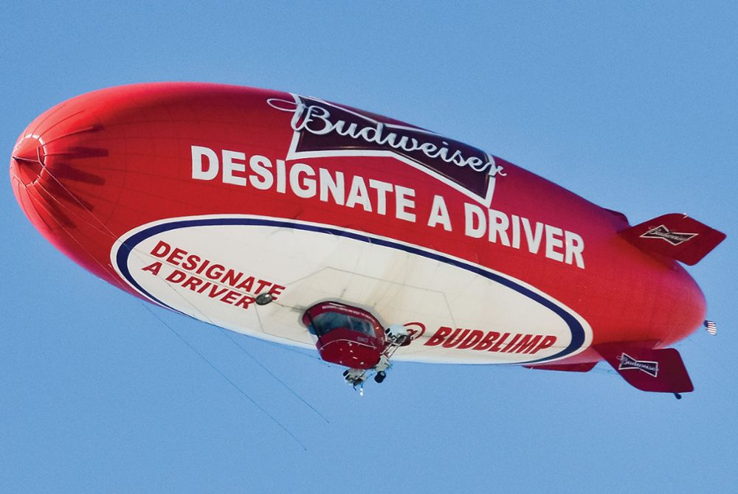

ANHEUSER-BUSCH: BECOMING THE BEST BEER COMPANY IN A BETTER WORLD
Alcohol Responsibility
Responsible Drinking Campaign
Online Campaign
Environmental Preservation
Inside and Outside Breweries
Reduced Water Use and Increased Recycling Rate
Responsibility
Matters Ad
©Richard Ulreich/ZUMA Press/Newscom

Slide 4
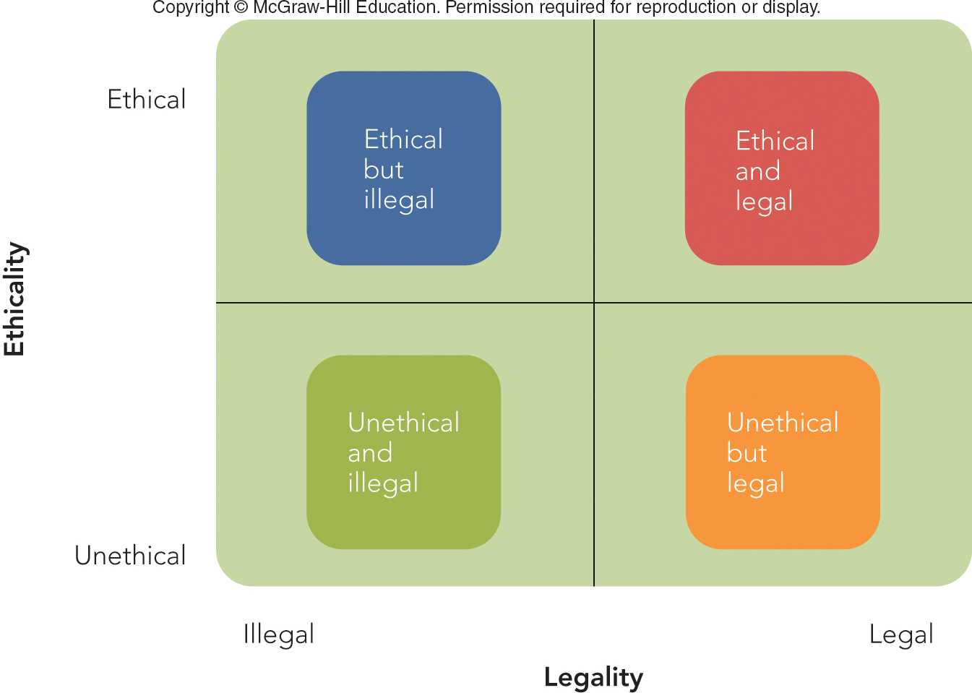
FIGURE 4-1 Four ways to classify marketing decisions according to ethical and legal relationships

Slide 5
NATURE AND SIGNIFICANCE OF MARKETING ETHICS (2 of 2)
Which Cell in Figure 4.1 Best Fits These Situations?
Physicians Agree to Establish Fee Schedule for Health Services.
Computer Program for Car Dealers Omits Key Information for Buyers.
U.S. Tobacco Companies Advocate Free Trade to China; China Legally Restricts Tobacco Imports.
College Students Record Movies at Theater, then Upload to Internet

Slide 6
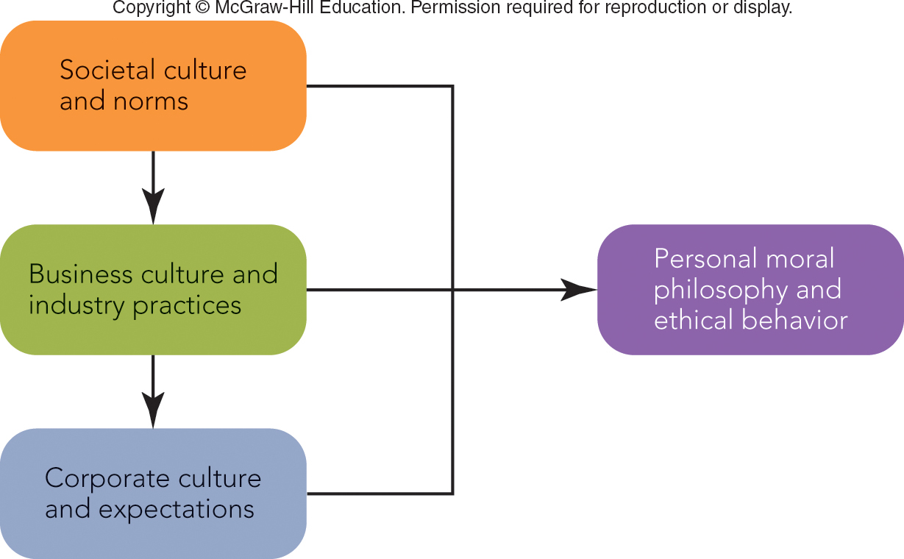
FIGURE 4-2 A framework for understanding ethical behavior
Jump to Appendix 1 long image description

Slide 7
ETHICAL MARKETING BEHAVIOR SOCIETAL CULTURE AND NORMS
Culture
Values, Ideas, and Attitudes That Are Learned and Shared
Societal Values and Attitudes
Are Relative
Affect Ethical and Legal Relationships

Slide 8
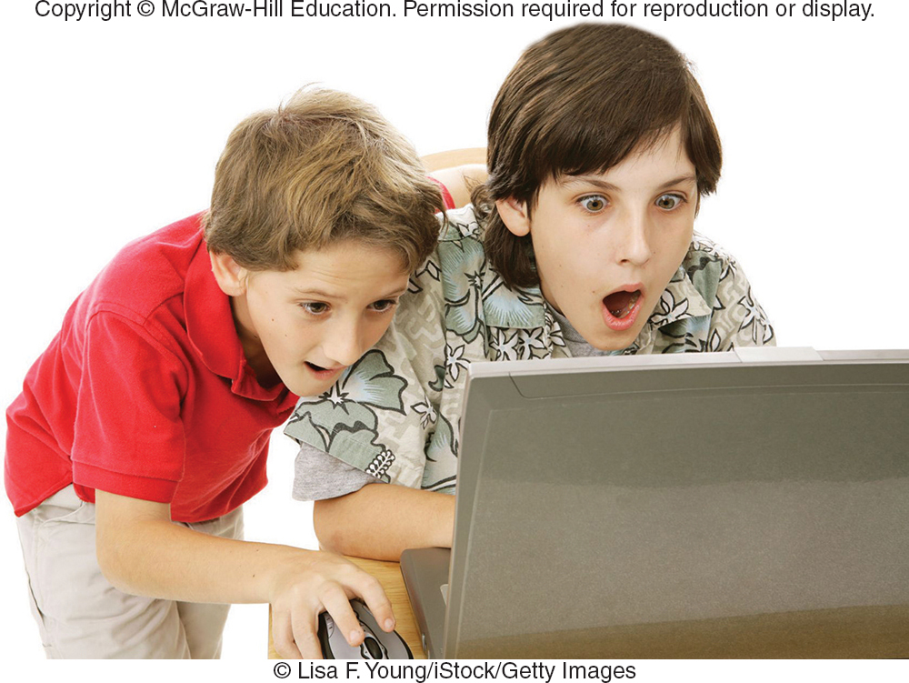
ETHICAL MARKETING BEHAVIOR BUSINESS CULTURE AND INDUSTRY PRACTICES (1 of 4)
Business Culture
Ethics of Exchange
Caveat Emptor
Consumer Bill of Rights (1962)
The Right:
To Safety
To Choose
To Be Informed
To Be Heard
©Lisa F. Young/iStock/Getty Images

Slide 9

ETHICAL MARKETING BEHAVIOR BUSINESS CULTURE AND INDUSTRY PRACTICES (2 of 4)
The Right to Safety
Consumer Product Safety Commission
The Right to Be Informed
Federal Trade Commission (FTC)
Consumer Product
Safety Commission
Federal Trade Commission

Slide 10
ETHICAL MARKETING BEHAVIOR BUSINESS CULTURE AND INDUSTRY PRACTICES (4 of 4)
Ethics of Competition
Most Common Unethical Behavior:
Economic Espionage
Corruption
Bribes
Kickbacks

Slide 11
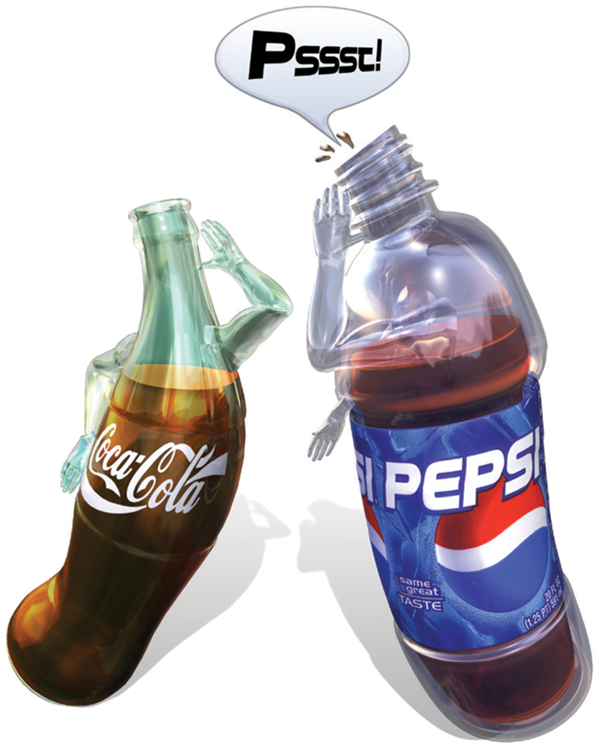
MAKING RESPONSIBLE DECISIONS CORPORATE CONSCIENCE IN THE COLA WAR
Situation:
You Are an Executive at Pepsi
Coke Employee Offers to Sell the Marketing Plan and Sample of New Product.
What Would You Do?
A Survey of Marketing and Ad Execs had 67% Say They Would Buy
©Cliff Tew

Slide 12
FIGURE 4-3 American Marketing Association Statement of Ethics (Abridged)
General Norms
Marketers should do no harm.
Marketers must foster trust in the marketing system.
Marketers must embrace, communicate and practice the fundamental ethical values.
Ethical Values
Honesty – to be truthful and forthright in our dealings with customers and stakeholders.
Responsibility – to accept the consequences of our marketing decisions and strategies.
Fairness – to try to balance justly the needs of the buyer with the interests of the seller.
Respect – to acknowledge the basic human dignity of all stakeholders.
Openness – to create transparency in our marketing operations.
Citizenship – to fulfill the economic, legal, philanthropic and societal responsibilities that serve stakeholders in a strategic manner.

Slide 13
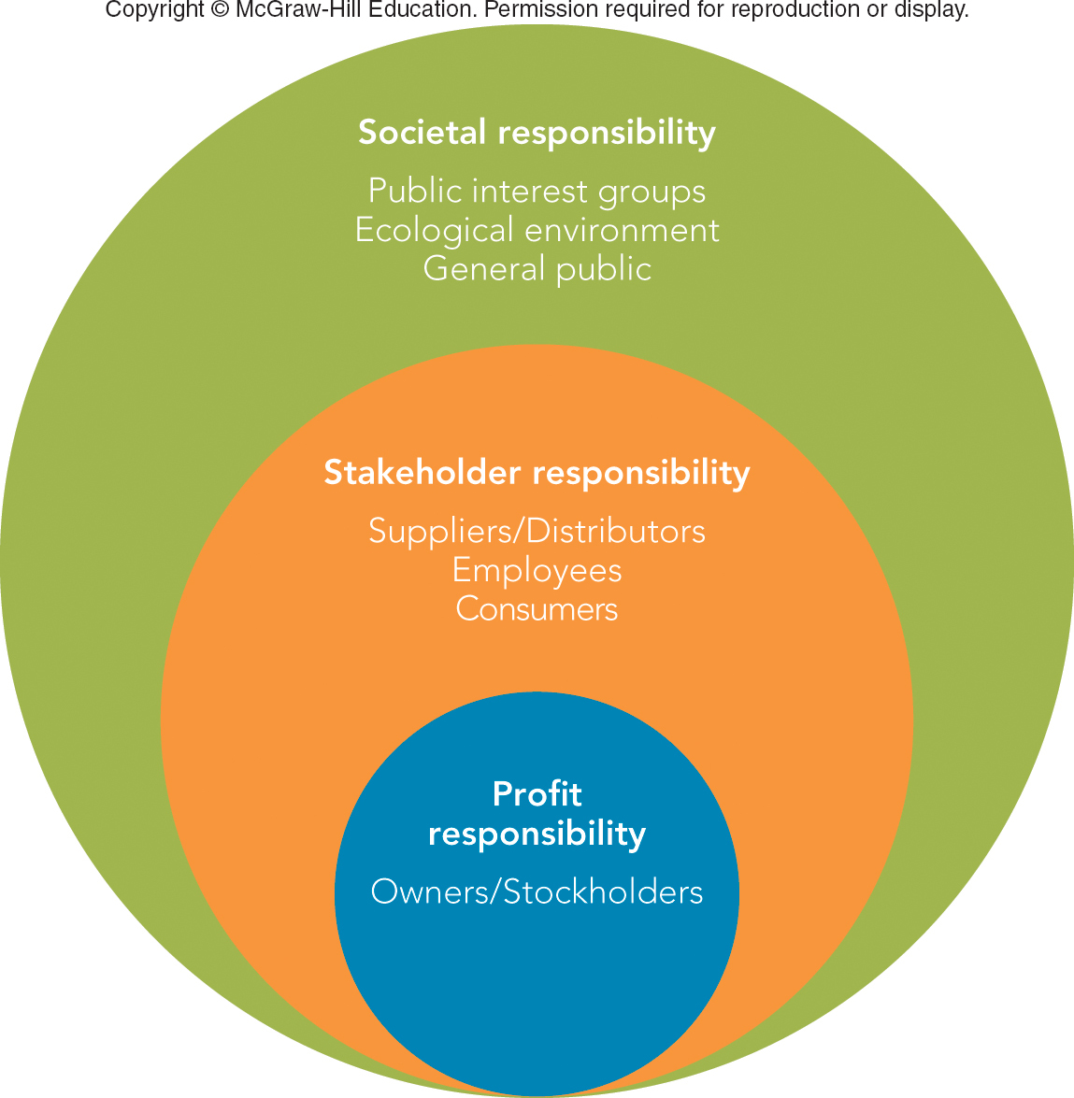
FIGURE 4-4 Three concepts of social responsibility
Jump to Appendix 2 long image description

Slide 14
MARKETING MATTERS Will Consumers Switch Brands for a Cause? Yes, if …
Cause Marketing Benefits Companies as well as Causes
Estimated $12 Billion Raised in Cause Marketing in 2016
85% of U.S. Consumers Have More Favorable Opinion of Companies that Support Causes
80% of Consumers will Switch to Brand that Supports a Cause

Slide 15
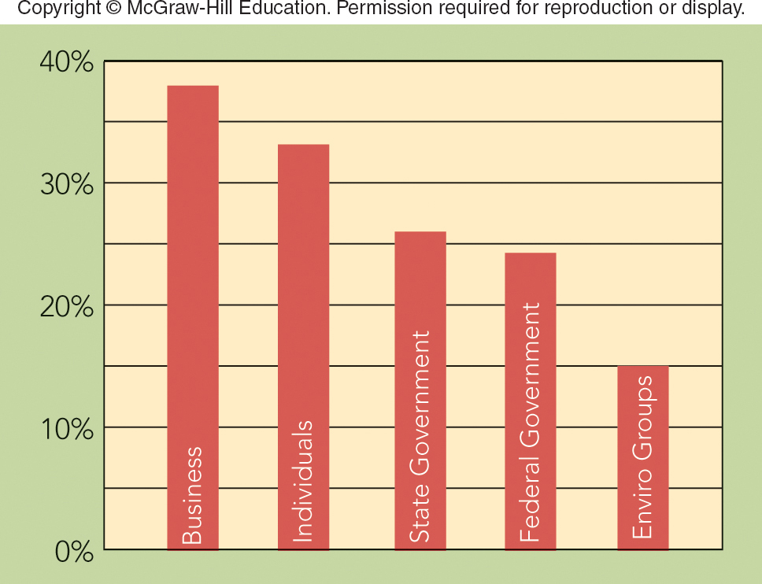
FIGURE 1 Who should take the lead in addressing environmental issues?
Jump to Appendix 3 long image description

Slide 16
Case Study Review
Mary Bara, General Motors
GM History
Ignition switch failure

Slide 17
GM Leadership Study – Group Work
Old GM culture vs. “new” GM culture
What behaviors & work experience contributed to Marry Barra’s success? Why?
What key factors contributed to GM’s poor performance up to the 2009 bankruptcy?
How did Barra handle the ignition switch crisis?
Explain “the GM nod”, how does this contribute to management failures
How does GM prosper moving forward?

Slide 18
Announcements/Assignments for next week……
Martin Luther King Holiday on Monday, NO CLASS
Wednesday, January 22^{nd -} Read Chapter 5 Consumer Behavior
Office hours moved to Thursday, January 23rd 2:30 – 4:30 p.m. 2N108
Rady Labs reminder! Earlier the better, don’t wait; slots fill up quickly
See you next Wednesday!

Slide 19
The Rady School of Management
Lecture #4
Ethical & Social Responsibility in Marketing
“Inclusive Leadership: Mary Barra”
MGT 103 Product Marketing & Management
M,W 11:00 a.m. – 12:20 p.m., OSTRSN 1S114
Professor Burt De Mill

